Slide 1
Innovation Activities and Integration through Vertical Acquisitions
Laurent Fresard Universita della Svizzera italiana (USI), Swiss Finance Institute
Gerard Hoberg Marshall School of Business, University of Southern California
Gordon M. Phillips Tuck School at Dartmouth College and National Bureau of Economic
Research
Presented by Austin Francis

Slide 2
Research Question
The main research question investigates whether the stage of a firm's innovation development—unrealized or realized—affects its likelihood of being vertically acquired and how this stage influences the boundaries and organization of the firm​.
Notes:
The authors aim to answer a central question: When are companies likely to acquire other companies that are in the same production chain, and how does the stage of innovation influence this?
The main question is: "Does the stage of a company’s innovation (early vs. fully developed) affect its likelihood of being vertically acquired by another company?“
Why it matters: Companies often want to control their supply chains or distribution channels, but they also want to make sure that acquisition won’t mess up the target company’s innovation process or make it hard to keep creative people around.

Slide 3
Prior Literature
The paper builds on foundational theories of vertical integration and firm boundaries, such as the works of Williamson (1971) and Grossman and Hart (1986), which discuss incentives and opportunistic behavior in integration.
It also references studies that connect innovation activities to corporate boundaries, such as Atalay, Hortacsu, and Syverson (2014), who suggest that intangible assets, not physical shipments, are critical in vertical structures.
This study differentiates itself by focusing specifically on how innovation stages affect the motives and organization of vertically integrated acquisitions​.

Slide 4
Hypothesis
The authors hypothesize that vertical acquisitions are more probable when a firm’s innovation has transitioned from an unrealized state to a realized and legally protected form, as these stages alter the need for control and reduce holdup risks.
They posit that firms with realized innovation are more likely to integrate vertically as this phase allows for greater control transfer to the acquirer, ensuring alignment with commercialization needs​.
Notes:
Companies with early-stage (unrealized) innovation are less likely to be acquired. This is because early innovation depends heavily on the people working on it, and if these people leave or their work is disrupted by an acquisition, the innovation could stall.
Companies with mature, patented (realized) innovation are more likely to be acquired. Once an idea is patented, the risks of losing the innovation or key personnel decrease, and the acquirer can focus on bringing the product to market without much disruption.

Slide 5
Key Metrics
R&D Intensity: Defined as the ratio of R&D expenditure to sales, this measures unrealized innovation.
Patenting Intensity: Calculated as the number of patents per dollar of assets, this represents realized innovation.
Vertical Relatedness: A text-based measure to assess firm-pair vertical integration, addressing the limitations of NAICS-based metrics​.
Notes:
Analyzing company product descriptions from regulatory filings to see how similar they were to each other. For example, Tesla might mention batteries, electronics, and software in its reports, which would link it to companies in those fields.
Matching firms with each other based on these similarities. They used text-based metrics, which is just a fancy way of saying they looked at the words companies used to describe themselves and identified relationships based on shared product descriptions.
Once they had these relationships mapped out, they looked at actual acquisition data to see which types of companies were more likely to acquire or be acquired.

Slide 6
Results
The findings support the hypothesis, showing that firms are more likely to be acquired vertically when they have higher patenting (realized innovation) but lower R&D intensity.
Furthermore, vertical acquisitions identified with the text-based approach showed significant positive returns, indicating that such acquisitions are value-creating.
The data reveal that R&D spending tends to decline post-acquisition, while patents increase only around the acquisition period, reinforcing the alignment with commercialization rather than innovation development​.

Slide 7
Data Collection
The data comprises 61,463 firm-year observations from Compustat, EDGAR filings, and patent records from the United States Patent and Trademark Office (USPTO) for the period 1996-2013.
Firms in the sample are non-financial with annual sales above $5 million, and patenting data is combined from the NBER patent database and additional updates by Kogan et al. (2017)​.

Slide 8
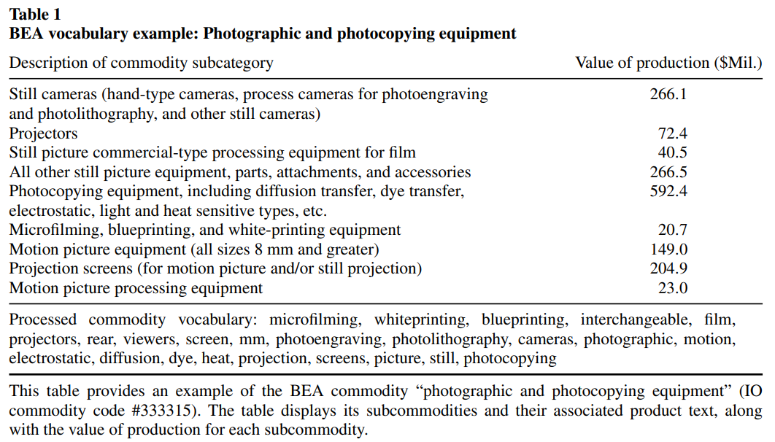

Slide 9
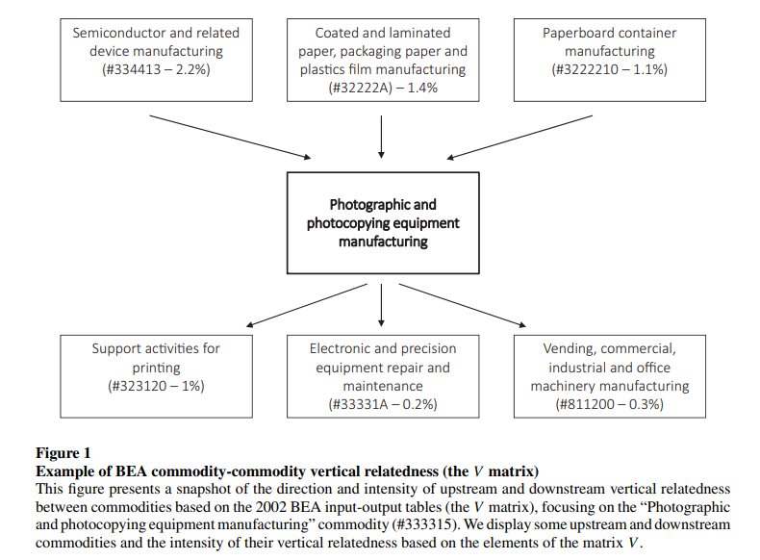

Slide 10
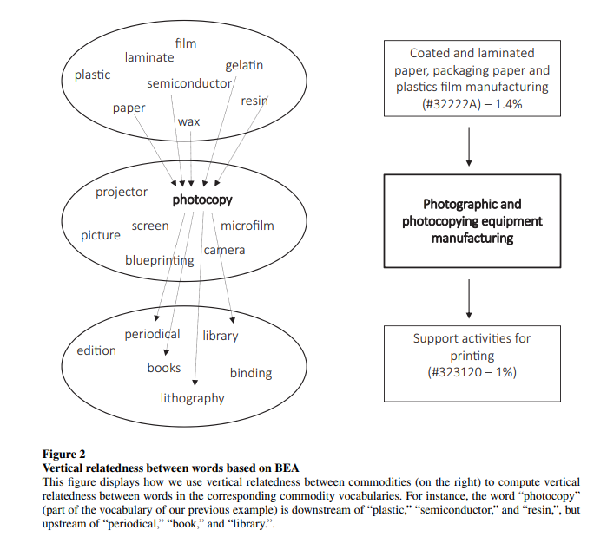

Slide 11
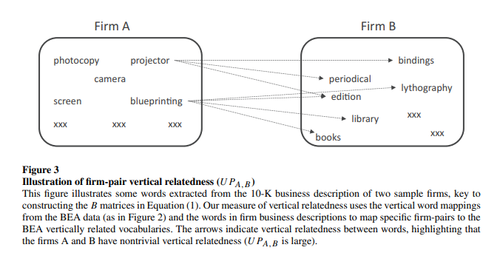
Notes:
The text-based network of vertically related firms is built by analyzing the words companies use to describe their products in official reports. Here’s how it works, simply:
Collect Product Descriptions: The method gathers descriptions from companies’ filings (like 10-K reports) where they talk about their products and services.
Match with BEA Product Vocabulary: Using a standardized vocabulary from the Bureau of Economic Analysis (BEA), which categorizes industries, the analysis identifies words that link different companies based on shared or related product terms.
Identify Vertical Relationships: If two companies have product descriptions that match or overlap in ways that suggest one could supply or complement the other, they’re identified as "vertically related." This creates a network showing potential supplier-customer connections between firms.

Slide 12
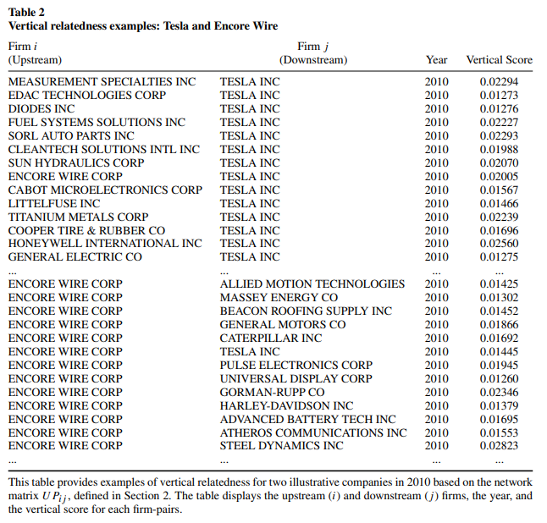

Slide 13
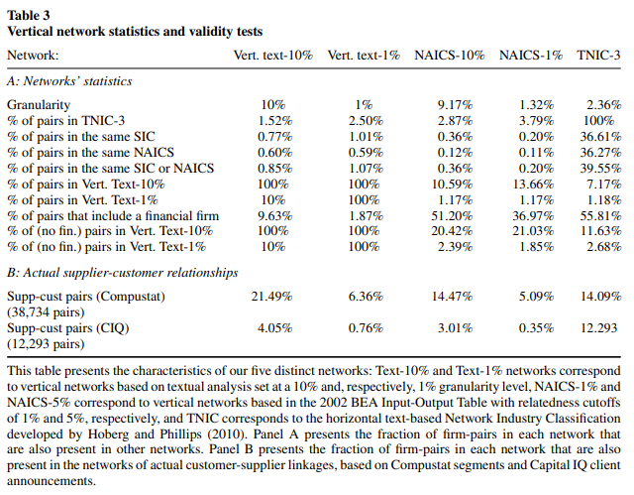
Notes:
Table 3 is designed to validate the way this study identifies "vertically related" firms.
It compares the study’s new text-based method of finding vertical relationships with the traditional NAICS classification method, which groups firms based on standard industry codes.
The text-based method finds many more pairs as vertically related than the NAICS-based method. This suggests the text-based method identifies more nuanced or specific relationships.
Overlap is low between the two methods (e.g., only 10.59% overlap in the 10% most related pairs), which means the text-based method is identifying relationships that NAICS might miss.
The study’s text-based method performs better at identifying real customer-supplier relationships, as shown by overlap with real-world supplier-customer data (last rows). This supports the idea that the text-based method is a good tool for identifying potential vertical relationships.

Slide 14
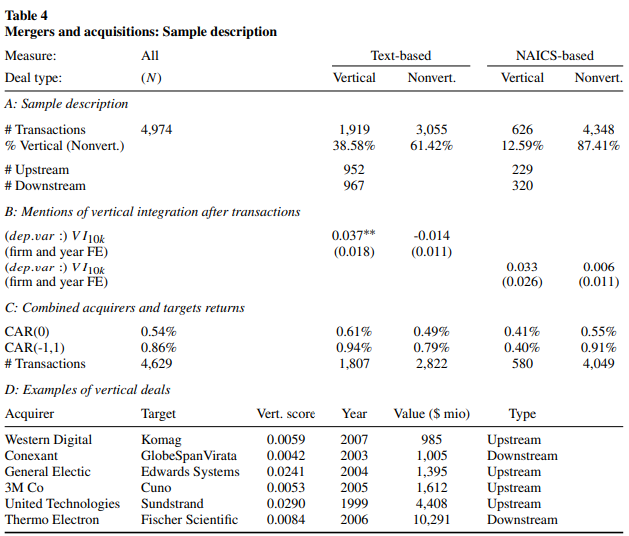
Notes:
Table 4 evaluates the outcomes of vertical vs. non-vertical acquisitions and checks if the study’s text-based method for identifying vertical relationships makes sense by looking at real-world effects on firms’ integration mentions and stock returns.
1. Purpose of Table 4
Table 4 aims to show that vertical acquisitions (companies buying their suppliers or buyers) are meaningfully different from non-vertical acquisitions.
It does this by looking at what happens to firms after these acquisitions in two areas: their language in official reports and stock market reactions.
Panel A: Sample Breakdown – This part shows how many acquisitions were classified as vertical or non-vertical using both methods (text-based and NAICS). It confirms that the text-based method finds more vertical deals (about 39% of deals are vertical vs. 13% using NAICS).
Panel B: Mentions of Vertical Integration – This measures how often firms mention “vertical integration” in their reports after an acquisition. Firms that did text-identified vertical acquisitions increased mentions of vertical integration significantly, which wasn’t as evident with NAICS-identified vertical acquisitions. This suggests the text-based method captures real integration intentions.
Panel C: Stock Market Reaction (CARs) – This part looks at cumulative abnormal returns (CARs), or how the stock prices reacted to the acquisition news. Text-identified vertical acquisitions had higher stock returns (0.86% for text-based vs. 0.40% for NAICS), suggesting investors view these acquisitions positively.
Panel D: Examples of Vertical Deals – Here, they provide specific examples of vertical acquisitions identified by the text-based method, showing real companies and their acquisition partners.
The text-based method captures more vertical acquisitions than NAICS, and these acquisitions are followed by a clear increase in vertical integration mentions in company reports.
Stock market reactions (CARs) are higher for text-identified vertical acquisitions, suggesting these are perceived as more value-adding.
Overall, the text-based method better identifies meaningful vertical relationships and acquisitions that are seen as beneficial by both firms and investor

Slide 15
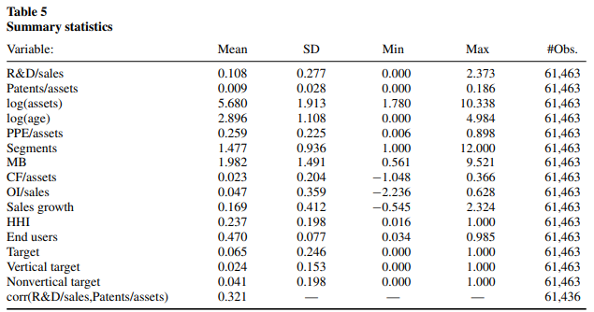
Notes:
R&D/sales and patents/assets vary widely, suggesting firms’ innovation strategies differ significantly in intensity.
The correlation between R&D/sales and patents/assets is moderate, indicating a diverse relationship between innovation expenditure and output.
Notable number: Mean R&D/sales ratio of 0.108​.

Slide 16
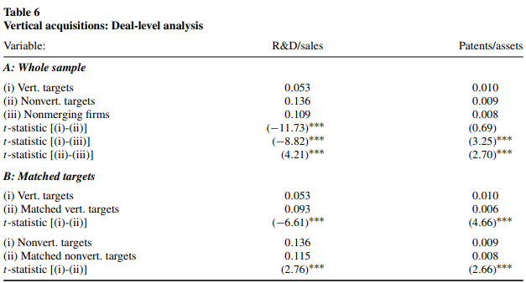
Notes:
Table 6: Vertical Acquisitions - Deal-Level Analysis
Table 6 investigates the innovation characteristics of firms involved in vertical vs. non-vertical acquisitions. It compares three groups of firms:
Vertically acquired firms (companies acquired by another firm in the same supply chain),
Non-vertically acquired firms (firms acquired by a company in a different part of the supply chain),
Non-merging firms (companies that were not acquired at all).
1. Purpose of Table 6
The table examines whether vertically acquired firms have different innovation profiles compared to non-vertically acquired or non-merging firms.
It uses R&D/sales as a proxy for early-stage, ongoing innovation and patents/assets as a measure of mature, realized innovation to see if these innovation characteristics influence acquisition likelihood in vertical transactions.
2. Explanation of Each Panel
Panel A (Whole Sample): This section compares the R&D and patenting intensity across vertically acquired targets, non-vertically acquired targets, and non-merging firms.
It shows that vertically acquired firms have lower R&D intensity (0.053) compared to non-vertically acquired firms (0.136) and non-merging firms (0.109). This suggests that firms in vertical acquisitions are typically past the early, innovation-heavy phase.
Patent intensity, however, is slightly higher for vertically acquired targets (0.010) than for non-vertically acquired targets (0.009) and non-merging firms (0.008), indicating that vertically acquired firms often have more mature, patented innovations.
Panel B (Matched Targets): This section further refines the comparison by matching each acquisition target with a similar firm (matched by size, industry, and other factors) that wasn’t acquired recently.
Results here reinforce Panel A findings: Vertically acquired targets have significantly lower R&D intensity (0.053) compared to matched, non-acquired firms (0.093).
Patent intensity remains higher for vertically acquired targets compared to matched non-acquired firms, confirming the trend that firms with more established (patented) innovation are attractive targets for vertical acquisitions.
R&D vs. Patent Intensity in Vertical Acquisitions: Vertically acquired firms tend to have lower R&D intensity, meaning they are likely beyond the early stages of innovation development, where control over innovation processes is more crucial.
Mature Innovation Drives Vertical Acquisitions: Higher patent intensity in vertically acquired targets suggests that vertical acquisitions are favored when a firm’s innovation is mature and legally protected, reducing risks associated with losing control of innovation.
Consistent Results Across Sample and Matched Comparisons: The pattern holds even when acquisition targets are matched to similar firms, confirming the robustness of the findings.

Slide 17
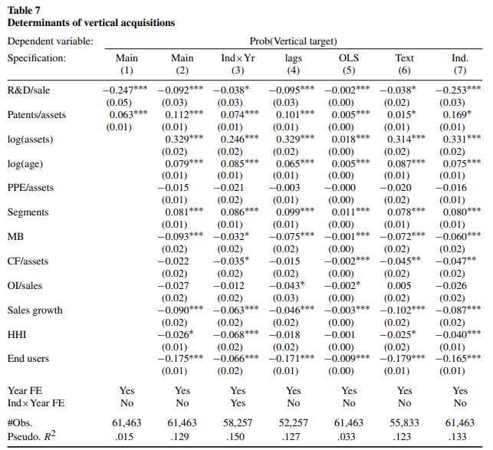
Notes:
This table tests the study’s core hypothesis: firms with ongoing innovation (high R&D) are less likely to be vertically acquired, while firms with mature, protected innovations (high patent intensity) are more likely to be acquired.
Table 7 also checks whether these results hold up under different statistical models and after including a variety of control variables.
2. Explanation of Each Column
Column 1 (Baseline): Shows the simple relationship between R&D intensity, patent intensity, and vertical acquisition likelihood.
R&D Intensity: Negative coefficient (-0.247), meaning that high R&D makes a firm less likely to be vertically acquired.
Patent Intensity: Positive coefficient (0.063), showing that firms with more patents are more likely to be targeted for a vertical acquisition.
Column 2 (With Controls): Adds control variables like firm size, age, profitability, growth, and industry concentration to see if R&D and patent intensity still matter.
R&D intensity remains negative (-0.092), while patent intensity stays positive (0.112), reinforcing the main finding.
Columns 3–7: These columns test different variations to ensure the results are robust:
Column 3: Adds industry-year controls to adjust for broader industry trends over time.
Column 4: Uses lagged values for R&D and patenting intensity to see if past innovation affects acquisition likelihood.
Column 5: Tests an alternative model type (linear probability model) instead of probit.
Column 6: Measures R&D and patenting intensity using mentions in firms’ regulatory filings instead of standard databases.
Column 7: Uses industry averages rather than firm-specific data, showing that the trend holds at the industry level too.
3. Key Takeaways from Table 7
R&D and Patent Intensity Show Opposite Effects: R&D intensity consistently has a negative impact on the probability of vertical acquisition, supporting the idea that firms with ongoing innovation prefer to stay independent. Patent intensity has a positive impact, meaning that firms with completed, legally protected innovations are more attractive for vertical acquisitions.
Robustness Across Models: The relationship between R&D, patent intensity, and acquisition likelihood holds across various model types and adjustments (e.g., including controls, using different time lags, and changing measurement methods).
Control Variables Also Matter: Other factors like firm size, age, and market-to-book ratio (a measure of growth prospects) also influence the likelihood of vertical acquisition, but R&D and patent intensity remain significant even when these controls are included.

Slide 18
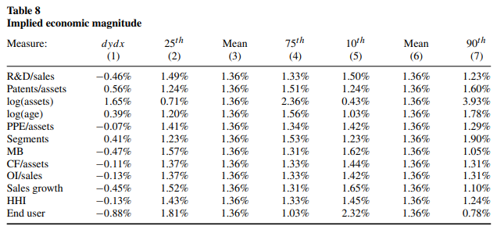
Notes:
Table 8 shows the economic importance of R&D and patent intensity by looking at how a one-standard-deviation change in each variable impacts the probability of vertical acquisition.
The table also explores percentile shifts for each variable, providing a clearer view of how acquisition probability varies when a firm’s characteristic (e.g., R&D intensity) is in the 25th vs. 75th percentile or 10th vs. 90th percentile.
2. Explanation of Each Column
Column 1 (Marginal Effects): Shows the percentage point change in acquisition probability when each variable increases by one standard deviation.
R&D Intensity: A one-standard-deviation increase is associated with a 0.46% decrease in acquisition likelihood, which is significant given that it represents about one-third of the average acquisition probability (1.36%).
Patent Intensity: A one-standard-deviation increase in patents raises acquisition probability by 0.56%, indicating that patents increase the attractiveness for vertical acquisitions.
Columns 2-4 (Percentile Comparisons): These columns show the predicted acquisition probabilities when the variable shifts between the 25th, mean, and 75th percentiles, holding everything else constant.
R&D Intensity: Moving from the 25th percentile (1.49%) to the 75th percentile (1.33%) reduces the acquisition likelihood slightly, in line with the idea that early-stage innovators are less likely to be acquired.
Patent Intensity: Moving from the 25th percentile (1.24%) to the 75th percentile (1.51%) increases the probability of acquisition, consistent with the idea that patents make firms more attractive for acquisition.
Columns 5-7 (10th and 90th Percentiles): These columns compare the acquisition probability when the variable shifts between the 10th, mean, and 90th percentiles, providing an even broader range.
For example, patent intensity in the 10th percentile corresponds to an acquisition likelihood of 1.24%, while at the 90th percentile, it reaches 1.60%, underscoring how high patent levels make acquisition more likely.
3. Key Takeaways from Table 8
Significant Impact of R&D and Patent Intensity: R&D intensity and patent intensity both have strong economic effects on acquisition probability. High R&D intensity reduces the likelihood of acquisition, while high patent intensity increases it, supporting the hypothesis that mature innovation attracts vertical acquisition.
Magnitude Relative to Other Factors: The impact of R&D and patent intensity on acquisition probability is large and comparable to other important factors, such as firm age, market-to-book ratio, and sales growth, demonstrating the substantial influence of innovation stage on acquisition decisions.
Variability Across Percentiles: Changes across percentiles (25th to 75th and 10th to 90th) confirm that as firms move from lower to higher patent levels, their attractiveness for acquisition increases, while higher R&D levels correspond with lower acquisition likelihood.
In Summary
Table 8 underscores that R&D and patent intensity are economically significant in predicting acquisition likelihood. Firms with more R&D are less likely to be vertically acquired, while those with more patents are more attractive for acquisition, suggesting that mature, protected innovation is a key driver for vertical integration. The table confirms that these effects are robust and of considerable size relative to other factors.

Slide 19
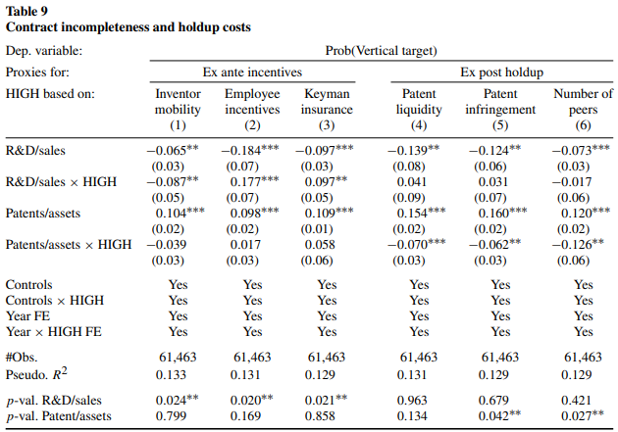
Notes:
Table 9 focuses on the role of incentive provision and holdup costs in vertical acquisitions. It tests whether the negative relationship between R&D intensity and vertical acquisitions is stronger in firms with higher risk of losing key inventors or higher costs of maintaining innovation incentives, which would make them less attractive for integration. It also checks if patent intensity (mature innovation) makes acquisitions more likely when holdup risks are minimized.
1. Purpose of Table 9
This table digs into the mechanisms behind the main hypothesis: that vertical acquisitions weigh the trade-off between keeping innovation incentives (important in high R&D firms) and reducing holdup risk (where patents make a difference).
Table 9 uses interaction terms to check if factors like inventor mobility, employee incentives, and patent liquidity strengthen or weaken the effect of R&D and patent intensity on the probability of vertical acquisition.
2. Explanation of Each Column
Each column introduces a “HIGH” indicator variable representing a specific condition or characteristic that could affect the incentive or holdup costs of an acquisition:
Column 1 (Inventor Mobility): Tracks how likely inventors are to leave the firm. High mobility increases difficulty in maintaining incentives, making R&D-heavy firms less appealing for acquisition.
Column 2 (Employee Incentives): Measures how well firms retain employees through incentives, like stock options. Firms with strong incentives find it easier to keep talent after acquisition.
Column 3 (Keyman Insurance): Reflects whether firms use insurance on key employees, indicating the firm values maintaining specific talent.
Columns 4-6 focus on holdup risks:
Patent Liquidity (Column 4): High liquidity suggests patents are easily transferred, lowering holdup risk.
Patent Infringement Risk (Column 5): Firms more prone to patent disputes may face higher costs in vertical integration.
Number of Horizontal Peers (Column 6): Indicates competitive pressure, possibly impacting innovation incentives.
R&D and Patent Interactions:
R&D Intensity Interactions: Significant negative coefficients (e.g., -0.065 in Column 1) indicate that high R&D firms are less likely to be acquired when maintaining innovation incentives is difficult (e.g., high inventor mobility).
Patent Intensity Interactions: Positive coefficients (e.g., 0.104 in Column 1) indicate that high patent firms are more attractive for acquisition, especially when holdup costs are low, like in firms with high patent liquidity.
Incentive Challenges and R&D-Heavy Firms: High R&D firms face reduced acquisition likelihood when it’s hard to keep inventors or incentives, confirming that early-stage innovation prefers independence to protect innovation incentives.
Patent Intensity and Low Holdup Risk: High patent intensity encourages acquisition when patents are more liquid or less risky, highlighting that mature, transferable innovation is attractive in acquisitions.
Significance Across Conditions: Results hold across different settings, supporting the hypothesis that the stage of innovation and the ease of maintaining incentives are crucial in acquisition decisions.

Slide 20
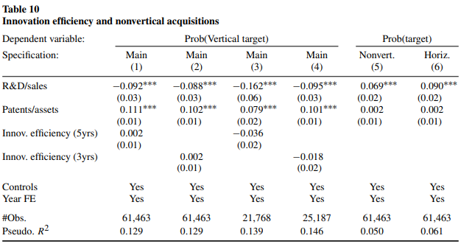
Notes:
1. Purpose of Table 10
Table 10 checks if firms’ innovation efficiency (patents per unit of R&D expense) might be behind the observed pattern in vertical acquisitions. If efficient innovators are more likely to be acquired, the R&D and patent relationship with vertical acquisitions might not be about the innovation stage at all.
It also tests whether non-vertical (or horizontal) acquisitions have similar relationships with R&D and patenting intensity, serving as a control to validate whether the incentive and holdup theories specifically apply to vertical acquisitions.
2. Explanation of Each Column
Columns 1-4 (Innovation Efficiency in Vertical Acquisitions): Adds controls for innovation efficiency by looking at patents relative to R&D over the past 3 or 5 years.
Finding: The inclusion of innovation efficiency doesn’t change the core relationship—R&D intensity is still negatively linked to vertical acquisitions, and patent intensity is positively linked, supporting the idea that it’s not just innovation efficiency driving acquisitions.
Column 5 (Non-Vertical Acquisitions): Examines non-vertical acquisitions, where firms are in unrelated parts of the supply chain.
Finding: Here, R&D-intensive firms are actually more likely to be acquired, suggesting that early-stage innovation may attract non-vertical (e.g., cross-industry) acquirers rather than vertical acquirers.
Column 6 (Horizontal Acquisitions): Examines horizontal acquisitions, where firms are in the same industry (direct competitors).
Finding: Like non-vertical acquisitions, R&D intensity is positively related, but patent intensity isn’t. This suggests that early-stage innovation increases attractiveness in horizontal deals as well, possibly due to competitive pressures in the same industry.
3. Key Takeaways from Table 10
Innovation Efficiency Does Not Drive Vertical Acquisitions: Controlling for innovation efficiency doesn’t change the results—vertical acquisitions are more influenced by whether the innovation is ongoing (R&D) or mature (patented), not just efficiency in innovation.
R&D Attracts Non-Vertical and Horizontal Acquisitions: Unlike vertical acquisitions, non-vertical and horizontal acquisitions are more likely to target R&D-intensive firms. This suggests that early innovation stages are more attractive outside the vertical supply chain, possibly due to competitive and market expansion reasons.
Patents Are Specific to Vertical Acquisitions: Patent intensity’s impact on acquisition is unique to vertical acquisitions, reinforcing that mature, protected innovation is particularly valuable in the same supply chain.

Slide 21
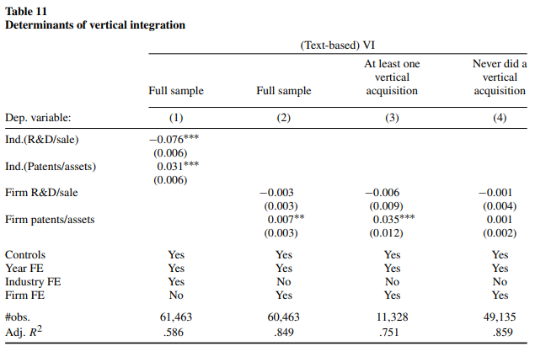
Notes:
1. Purpose of Table 11
Table 11 tests if firms or industries with different innovation stages (ongoing R&D or mature patents) show distinct levels of vertical integration, supporting the idea that innovation stage influences integration choices.
It also compares firms that have completed vertical acquisitions to those that haven’t, examining if patenting from acquisitions influences the extent of integration.
2. Explanation of Each Column
Column 1 (Industry-Level R&D and Patent Intensity): Uses industry averages for R&D/sales and patents/assets.
Finding: Firms in industries with high R&D intensity tend to be less vertically integrated, while those in industries with high patent intensity show more integration, indicating that ongoing innovation favors independence, while mature innovation encourages integration.
Column 2 (Firm-Level Changes in R&D and Patenting Intensity): Looks at vertical integration changes within firms over time, controlling for each firm’s unique characteristics.
Finding: There’s no significant link between R&D intensity and vertical integration changes, but patent intensity is positively related to integration. This suggests that firms only increase integration as innovation becomes more protected and mature.
Columns 3 and 4 (Vertical Acquirers vs. Non-Acquirers):
Column 3: Focuses on firms that have made vertical acquisitions.
Finding: For these firms, patent intensity positively correlates with integration, indicating that patents acquired through vertical deals support further integration.
Column 4: Focuses on firms that have never made a vertical acquisition.
Finding: In non-acquirers, vertical integration isn’t significantly related to either R&D or patent intensity, suggesting that the integration-patent relationship is driven by firms actively engaging in vertical acquisitions.
3. Key Takeaways from Table 11
Innovation Stage Shapes Integration: Firms in R&D-heavy industries are less integrated, supporting the idea that early innovation benefits from independence, while patent-heavy industries encourage integration.
Patents Drive Integration in Acquirers: Among firms making vertical acquisitions, patenting intensity (especially from acquired patents) promotes integration, implying that patents obtained through acquisitions support integration.
No Effect in Non-Acquirers: Firms without vertical acquisitions don’t show significant links between innovation and integration, confirming that integration patterns are tied to active acquisition strategies rather than organic growth alone.

Slide 22
Conclusion
Stage of Innovation Affects Acquisition Likelihood: Firms in early innovation stages (high R&D intensity) are less likely to be vertically acquired, preserving control and R&D incentives, while those with mature, patented innovation are more likely targets, supporting efficient commercialization and reducing holdup risk.
Theoretical Validation: Findings align with property rights and contracting theories, confirming that vertical acquisitions balance the need for innovation incentives (ex ante) with minimizing commercialization risks (ex post) in the integration decision-making process.
Notes:
7. Big Picture of the Results
The paper finds that companies with mature, protected innovations (e.g., patents) are attractive targets for acquisitions by related firms. On the other hand, companies that are still heavily investing in R&D (without a lot of patents) are more likely to remain independent. This suggests that companies in early innovation stages prioritize maintaining control, likely to avoid disrupting their innovation momentum.
In Summary
This study explains that when a company is bought by another firm in its supply chain, it often has something to do with the innovation stage:
Early-stage innovators (high R&D, low patents) are better off staying independent because they still need control and flexibility.
Mature innovators (high patents) are appealing for acquisition since their ideas are ready to market, and the acquiring firm can use the new technology immediately without much risk.

